Slide 2
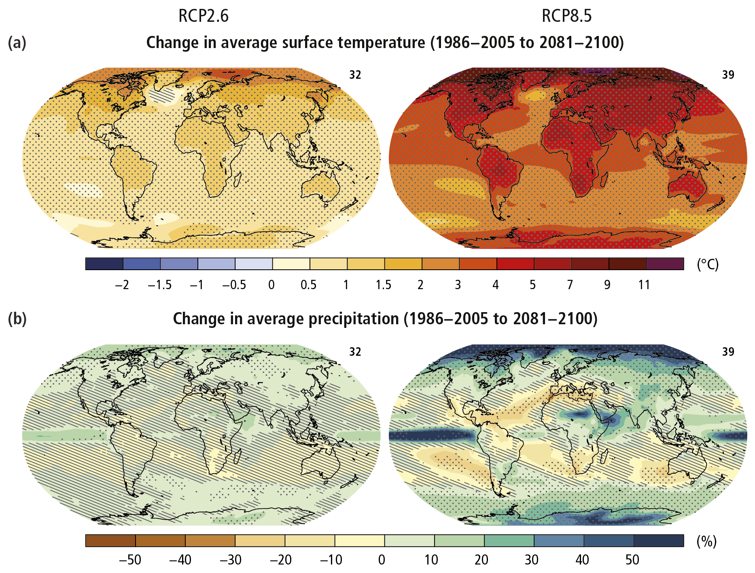
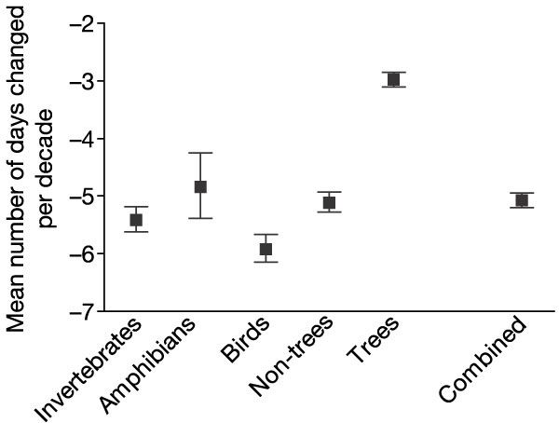
Climate Change and Phenology

Slide 3
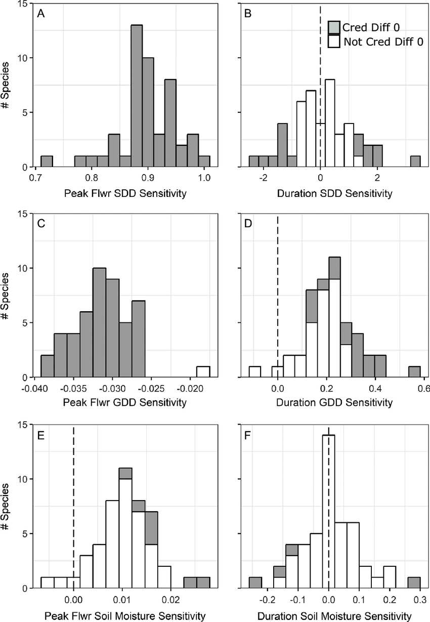
Phenological sensitivity
The shift in phenological event date per degree of temperature change

Slide 4
How does differential phenological sensitivity mediate plant interactions?

Slide 5
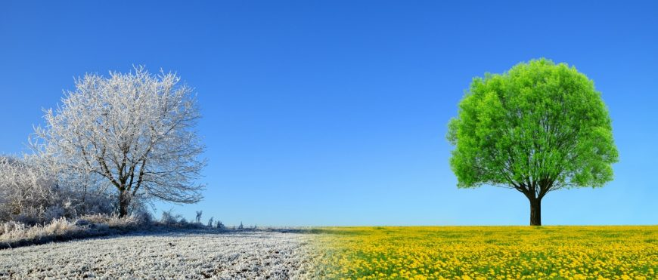
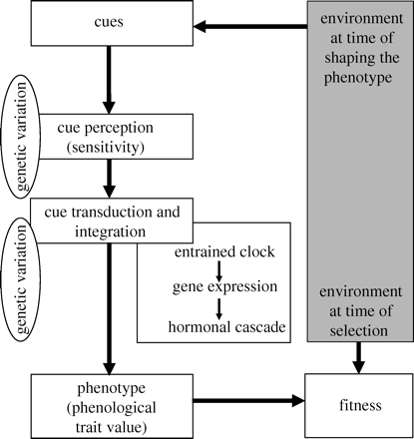
Phenological transition: dormancy to growth
Insert picture of bud and seed here
Optimum
Openworksweb.com
Visser 2010

Slide 6
Research Overview

Slide 7
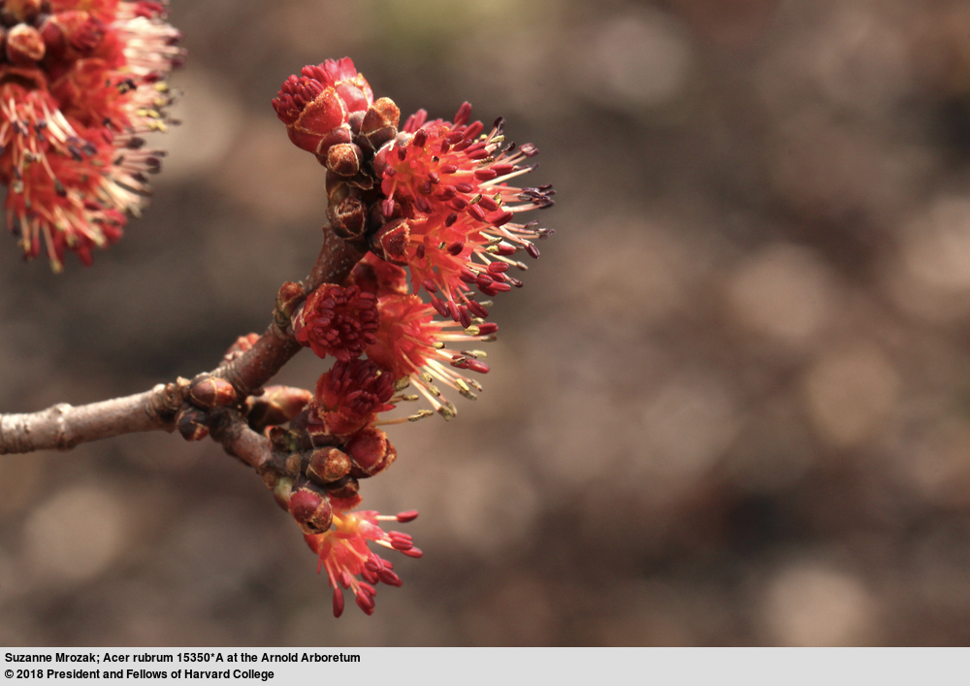
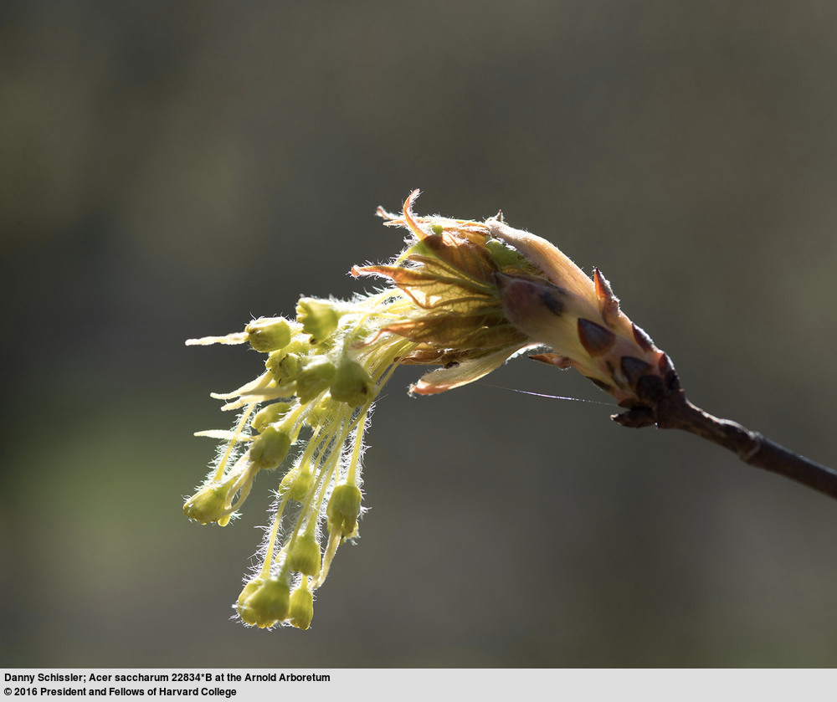
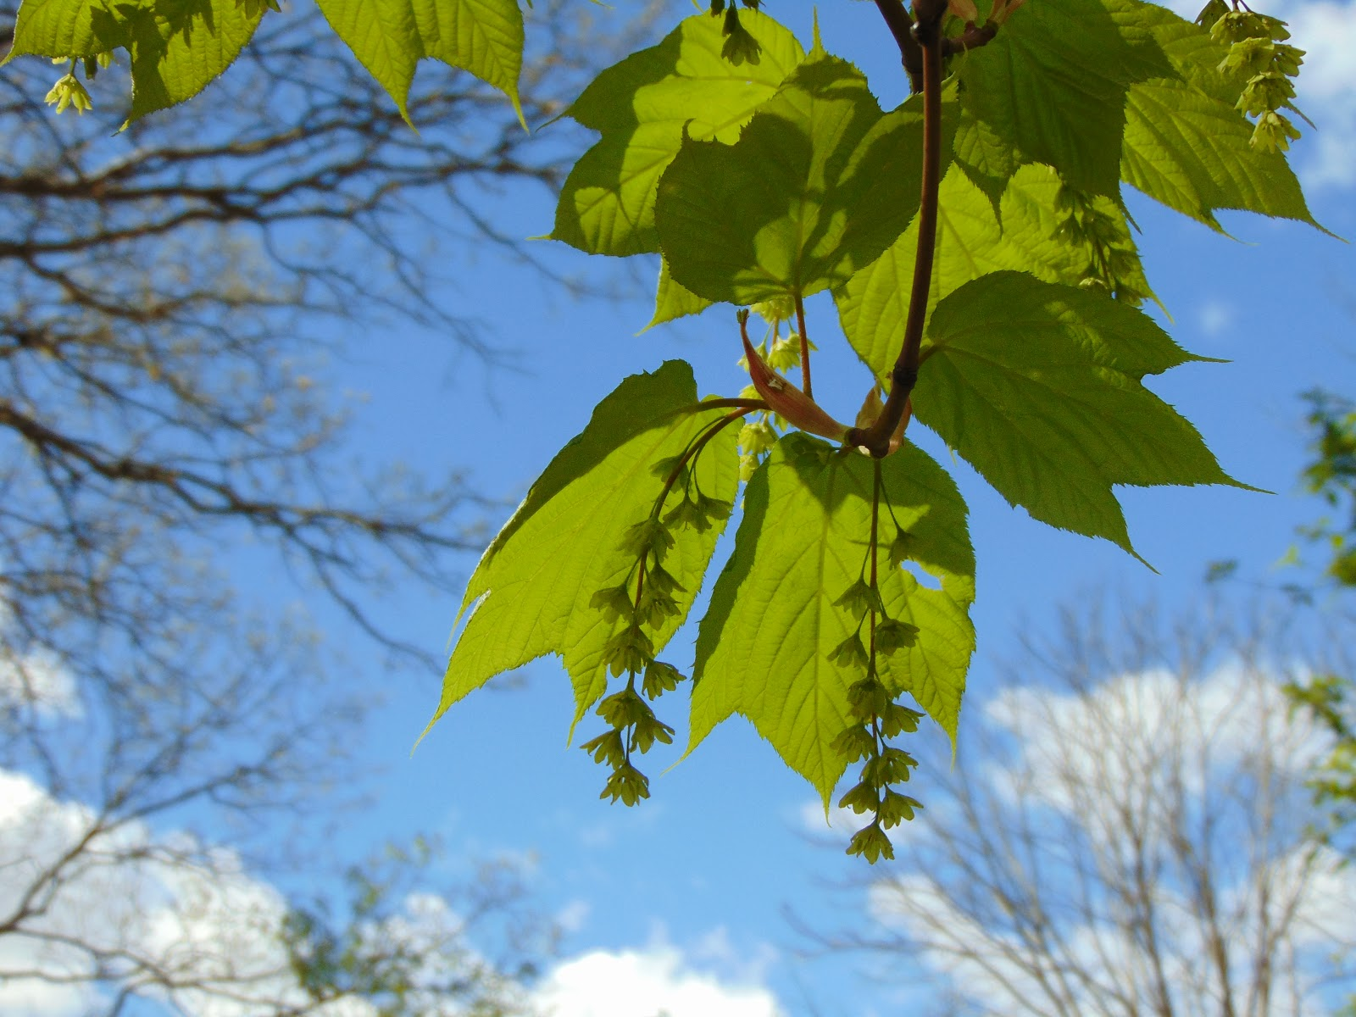
Background
Why do some temperate species flower before leafing out while others leaf first?
Notes:
1: l75 and fopn, 2 fbb and lbb,

Slide 8
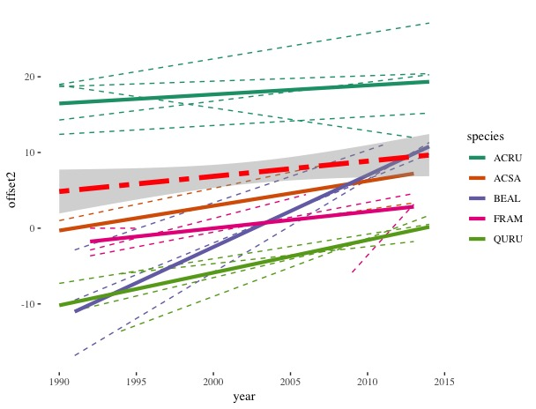
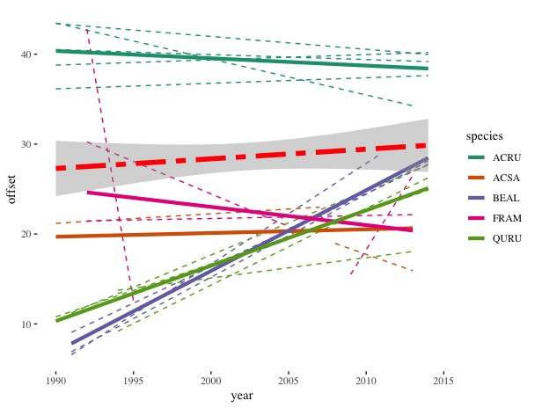
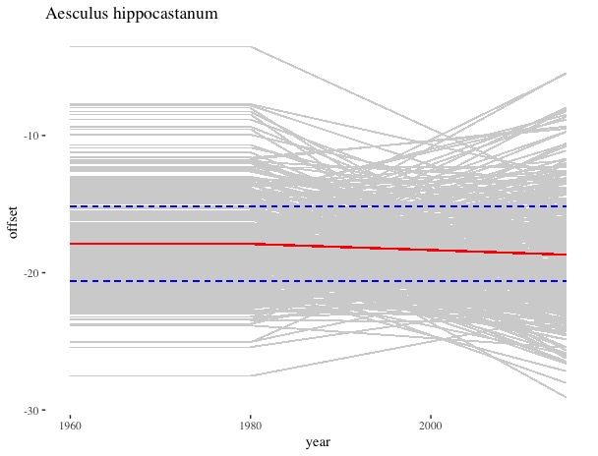
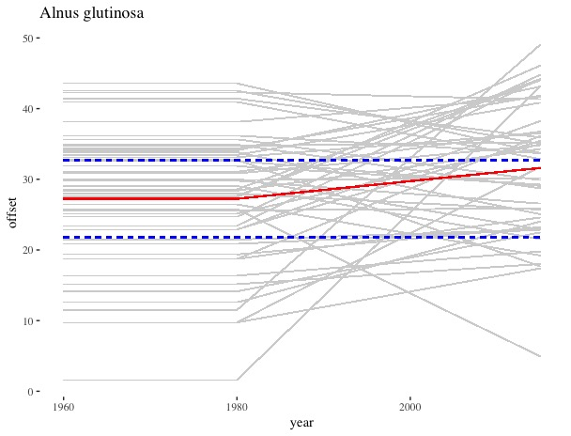
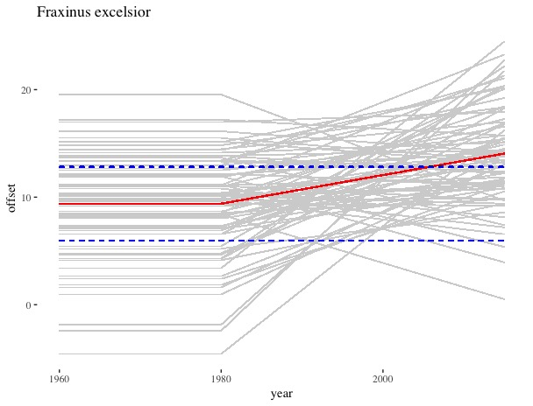
Background
Why do some temperate species flower before leafing out while others leaf first?
Notes:
1: l75 and fopn, 2 fbb and lbb,

Slide 9
Background
Hypotheses:
Wind pollination efficiency
Water relations*
Extreme early flowering
Phylogenetic constraint
Data limitation(s):
Limited quantitative data
Uncertainty in categorical data*
Research Questions:
Q1:
Q2:
Notes:
* I’ll talk more about this

Slide 10
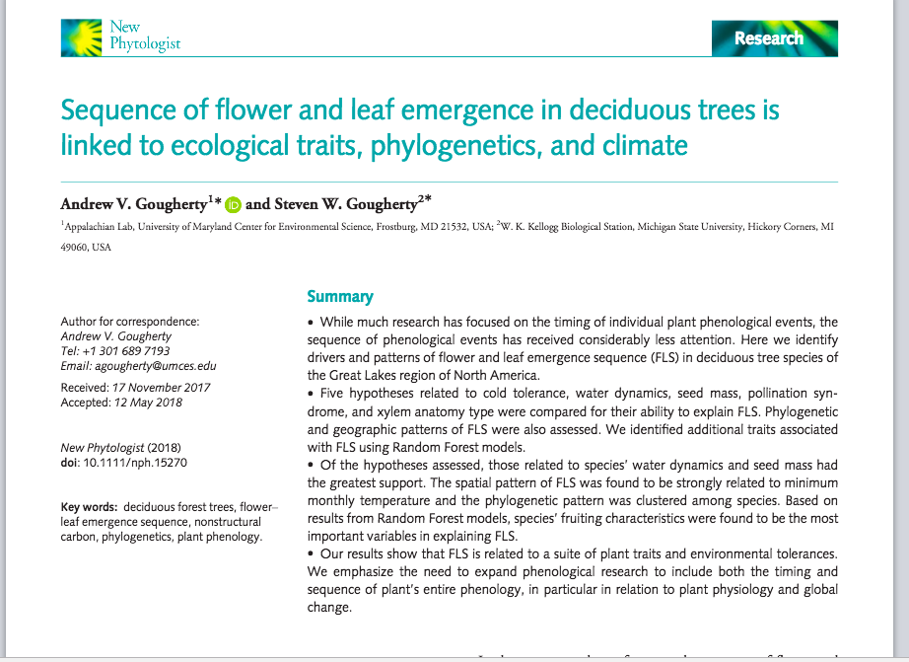
Methods

Slide 11
What does “flowers before leaves” really mean?
Sources of Uncertainty:
Observer
Geographic
Temporal
Modeling choices

Slide 12
Preliminary results
MTSV | D | USFS | D
Physiological | 0.29 | Physiological | 0.12
Intermediate | 0.16 | Intermediate | 0.11
Functional | 0.05 | Functional | 0.64

Slide 13
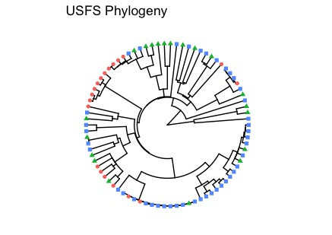
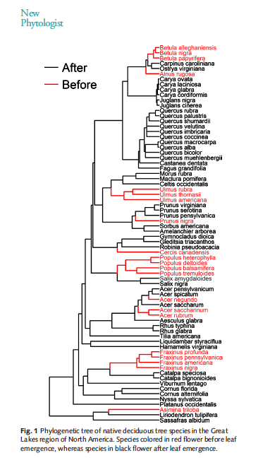
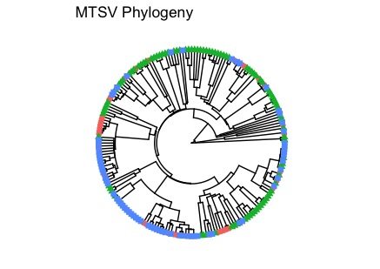
Preliminary results
Gourgherty 2018
Notes:
Red always hyst. Green, always ser. Bue tramsopmtopma;

Slide 14
Preliminary results
Suggesting:
Pollination syndrome, shade tolerance and early flowering associated with hysteranthous FLS
Upshot:
Quantitative data buffers against modeling choices, yeilding more stable predictions
Analysis will improve as more quantitative data are collected and become available (citizen science, long term monitoring)
Notes:
Red always hyst. Green, always ser. Transitions with recatagorization

Slide 15
Background
What drives variability in FLS?
How will climate change effect this variability
Hypotheses:
FLS variability is a produce by differential sensitivity between flower and leaf buds to climate cues
These sensitivity differences will alter FLS under climate change

Slide 16
Background
cool year
sensitivity
warm year
Winter Spring

Slide 17
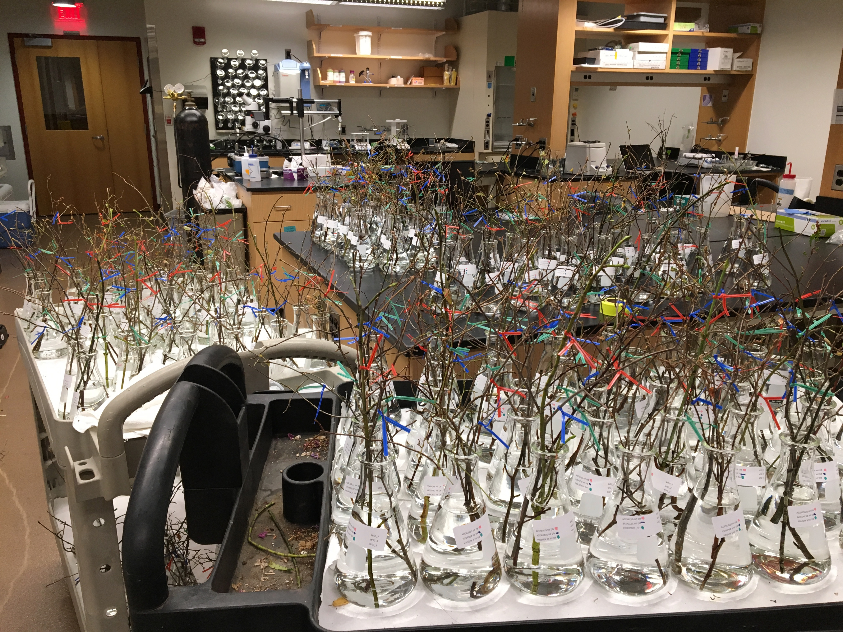
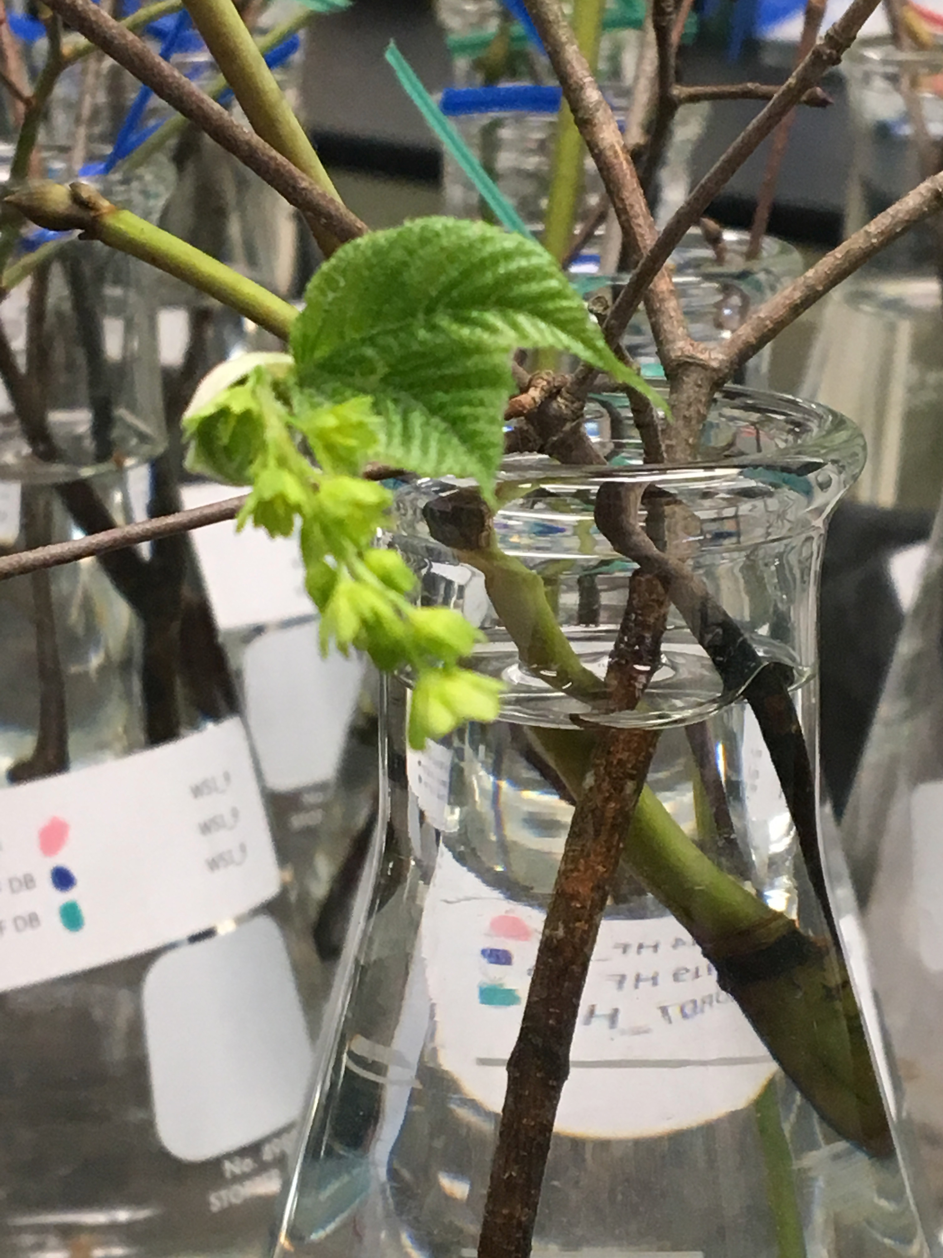
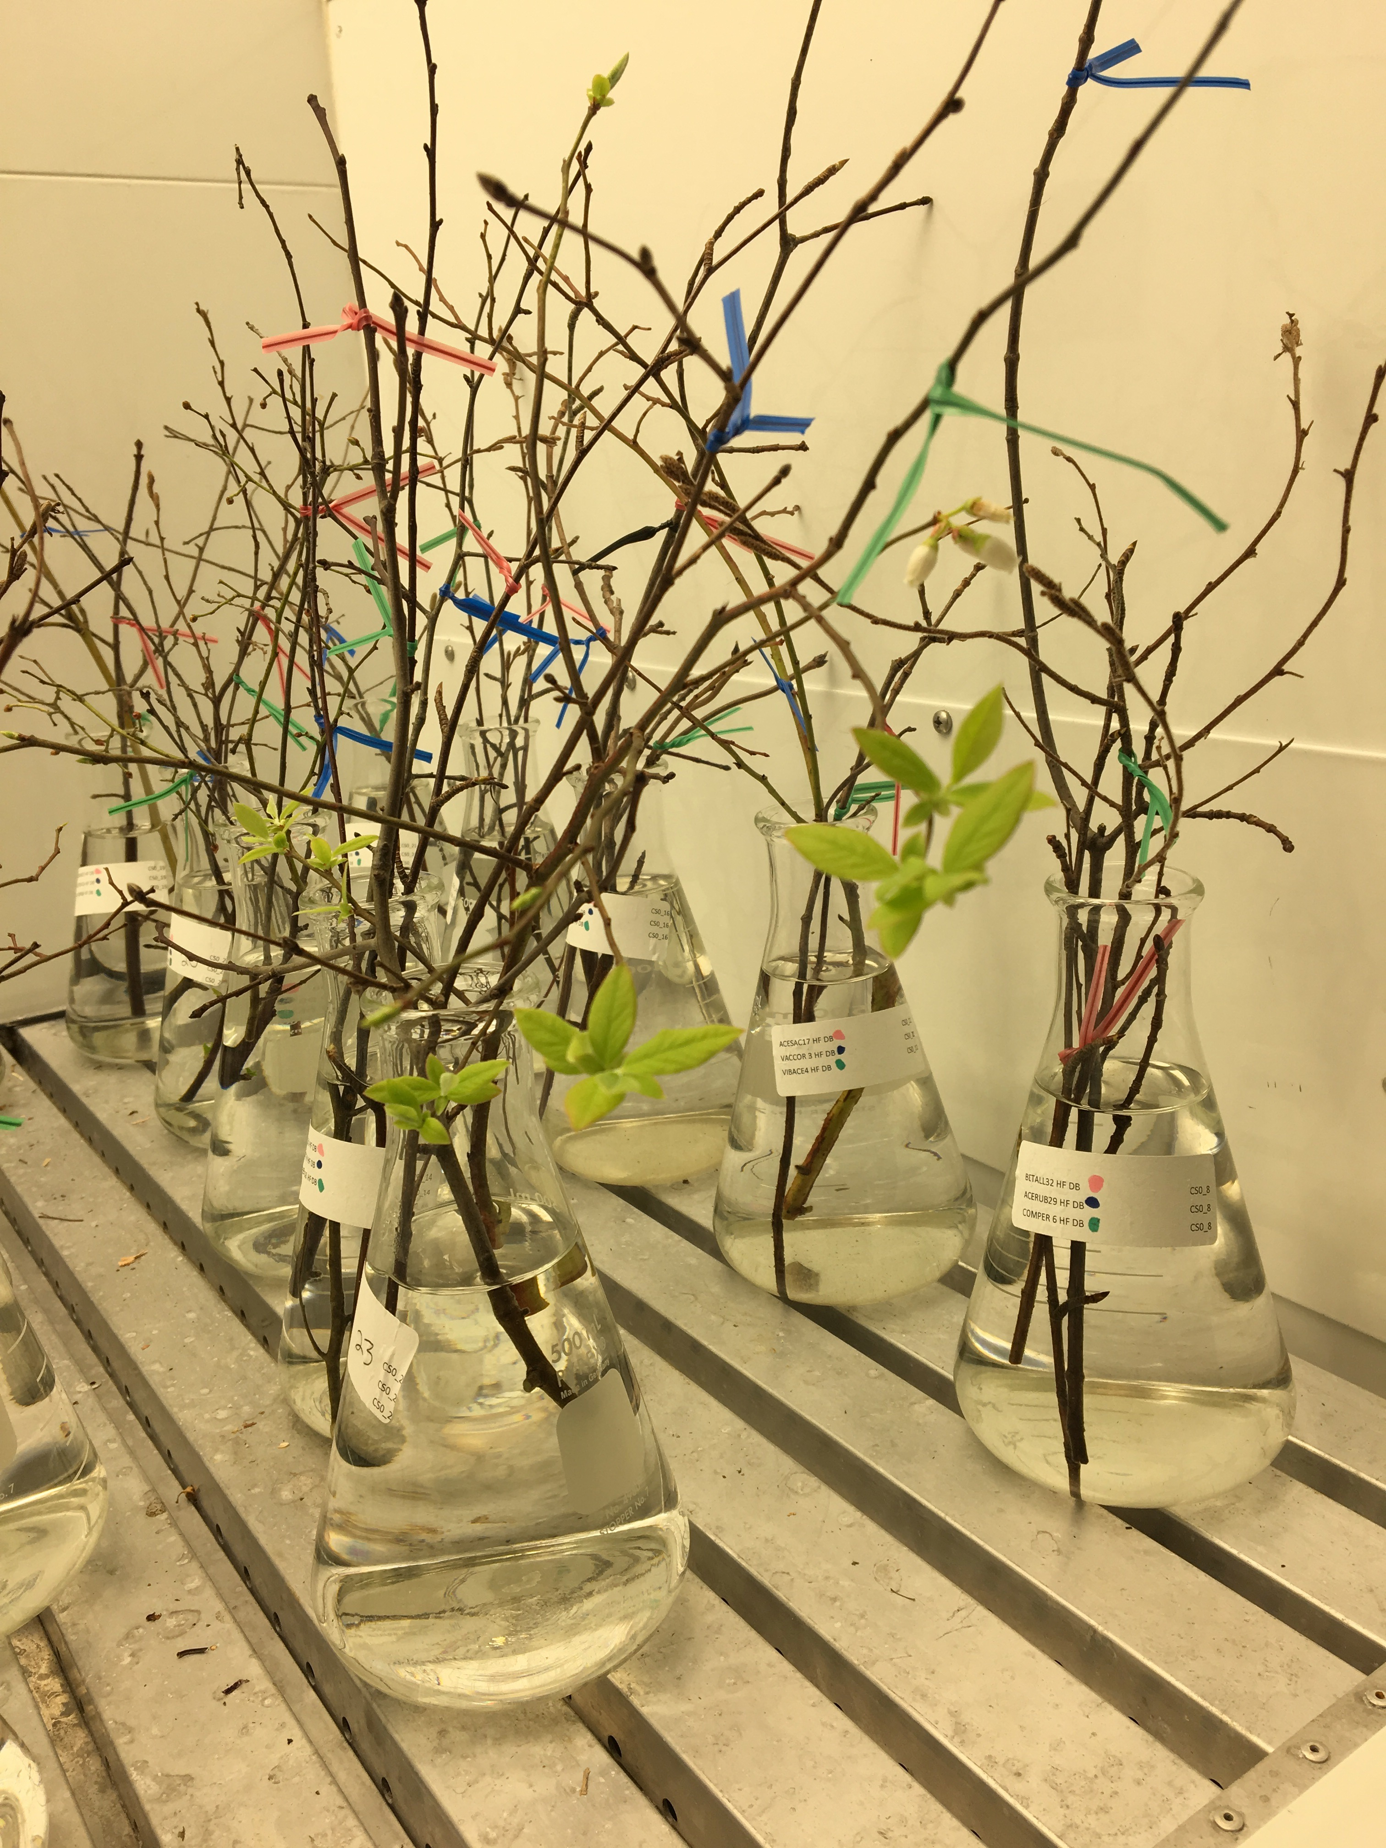
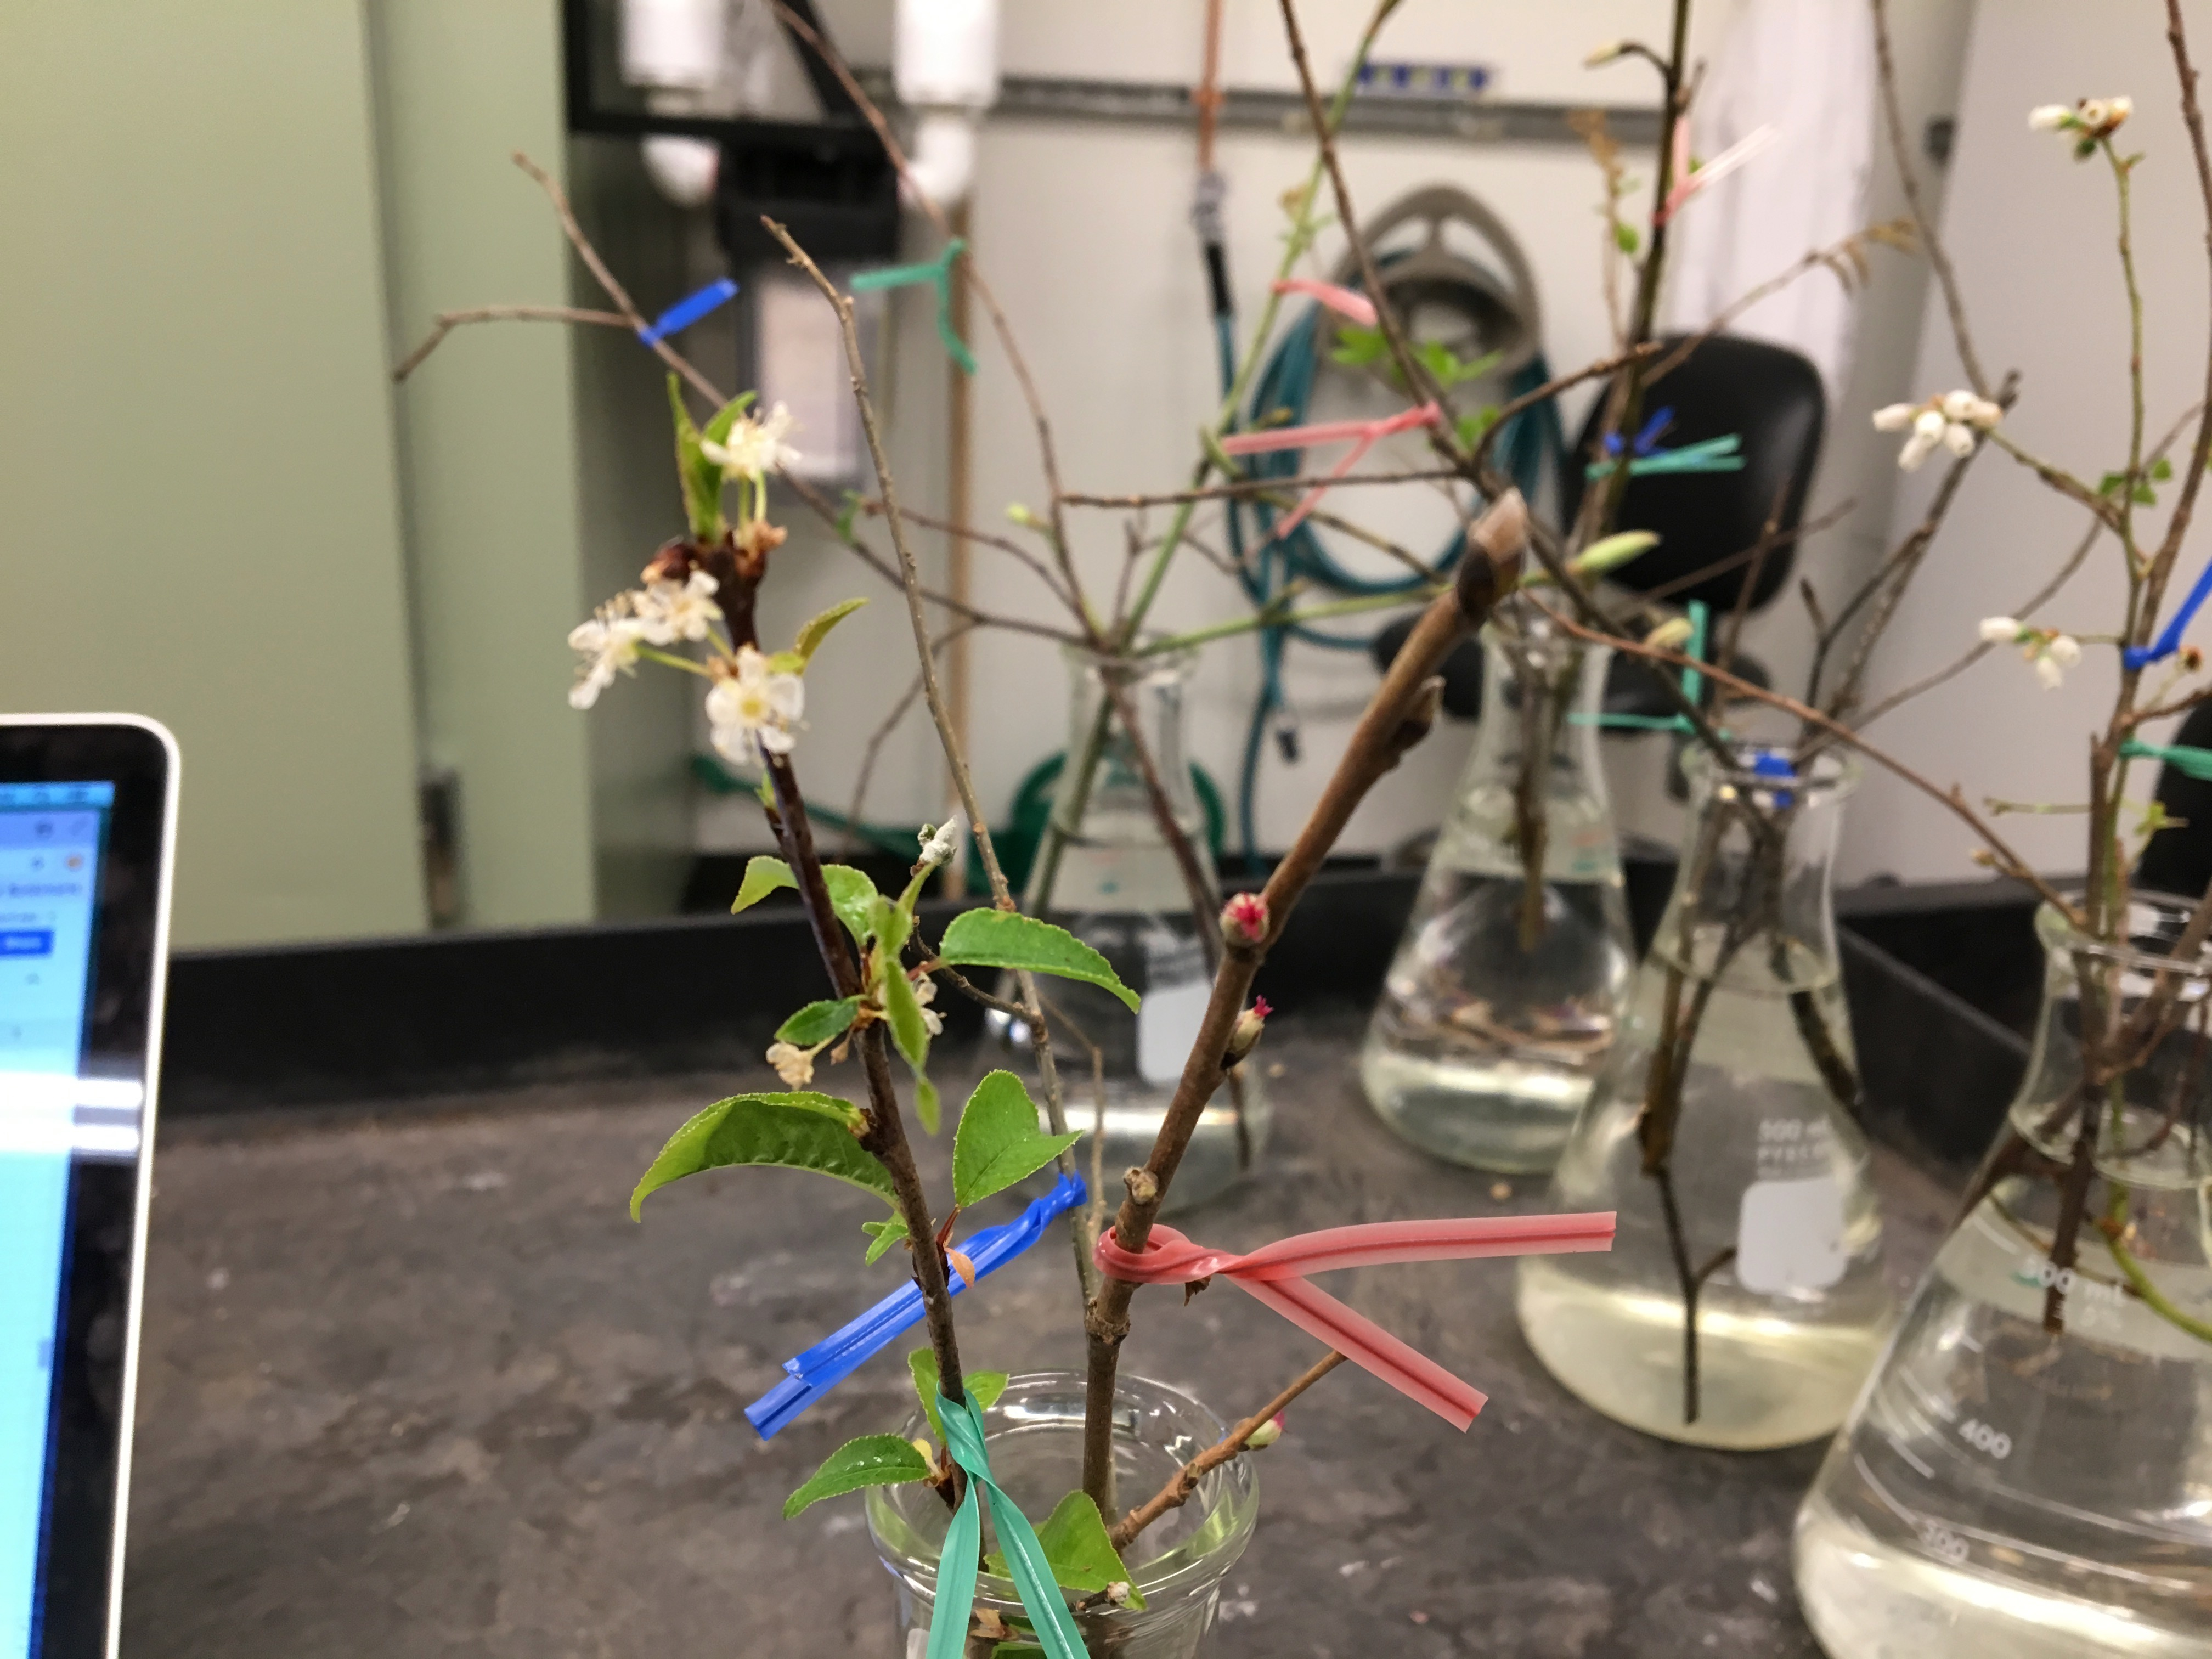
Methods
Sampling: October 2017.12 species, six replicates/species/treatment
Treatments: October 2017-February 2018. Two photoperiods, two chilling duration, two forcing conditions 12 way factorial.
Analysis: Ongoing. Hierarchical Survival Model.

Slide 18
Current status
Raw data shows FLS variability across treatments

Slide 19
Current status
Write model here
Model converges but provides low confidence estimates
Potential model improvements:
Convert phenology to binary
Run flower and leaf models separately, or for only species with the most data
Use offset as response variable

Slide 20
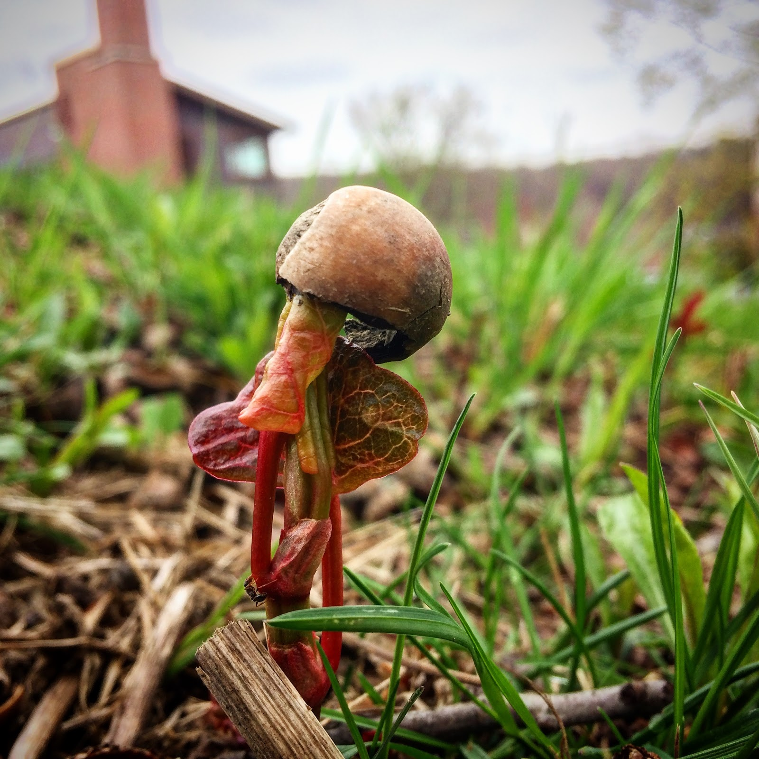
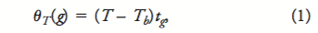
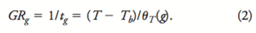
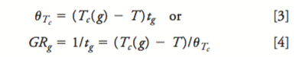
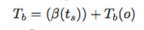
Temperature and Germination Phenology
Mean T_{b} @14 days stratification: 8.22
Mean T_{b} @ 28 days stratification: 5.32
lm( T_{b}~ stratification )
Intercept (T_{b(o)})= 11.12
stratification (beta)= -0.2071
Equations from Bradford 2002 and adapted from Pritchard 1999
Notes:
Before we can think about climate change effects of germination phenology, first we need to think about temperature
Threshhold model
Blue= t25, red t50,greent75. took the mean tb

Slide 21
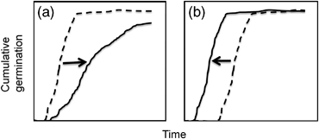
Background and questions
Walck 2011
Notes:
Shifts of germination phenology between now (dashed lines) and the future (solid lines) with global warming for species requiring cold stratification. (a) Seedling emergence will be delayed if the current length of cold stratification approximates the minimum requirement. In this case, shortened winters will not adequately overcome dormancy and seeds will require increased time in spring to germinate. (b) Emergence will be earlier if the current length of stratification greatly exceeds the minimum required. Seeds remain un‐germinated (but nondormant) until spring temperatures warm, and thus shortened winters do not affect dormancy break but premature spring warm‐up accelerates germination.

Slide 22
Background and Questions
Stratification in the model, drop in Tb
Notes:
Mathmaically and biological good

Slide 23
Methods
Sampling: Summer 2018. 14 herbaceous species from nursery stock or wild collected. Three replicates of 15-20 seed/treatment.
Treatments: August 2018-January 2019. Ten stratification periods, two incubation conditions for 20 way factorial experiment.
Analysis: Ongoing. Germination threshold models.
Show pictures of chambers here
Shpecies talbe

Slide 24
Project status

Slide 25
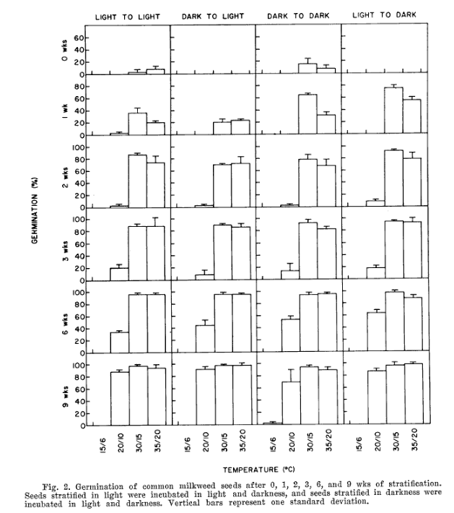
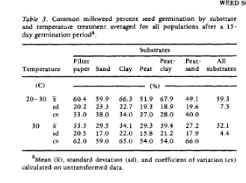
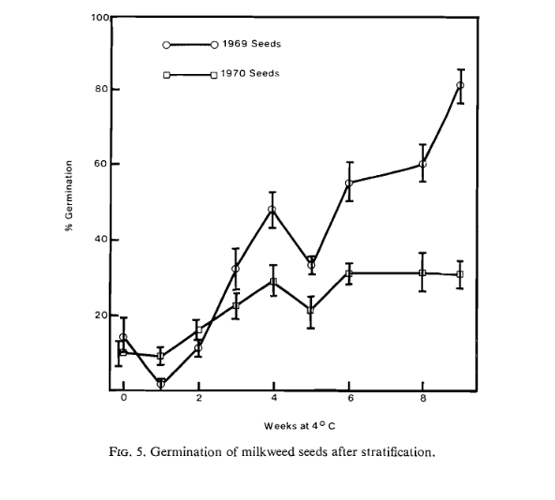
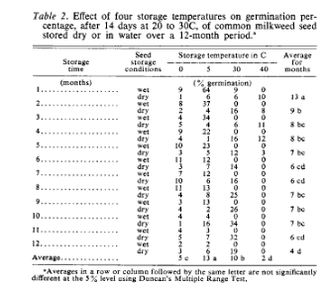
Background: OEGREs
Notes:
Evetts 1972
Oegema and Fletcher 1972
Farmer 1986
Baskin and Baskin 1977
Add picture of Ascleptias only

Slide 26
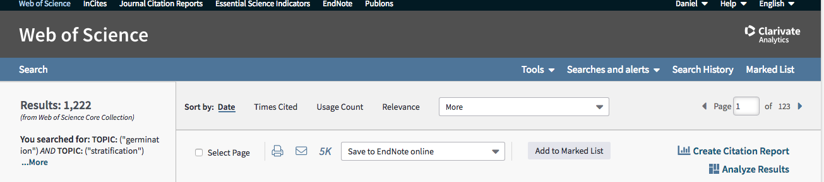
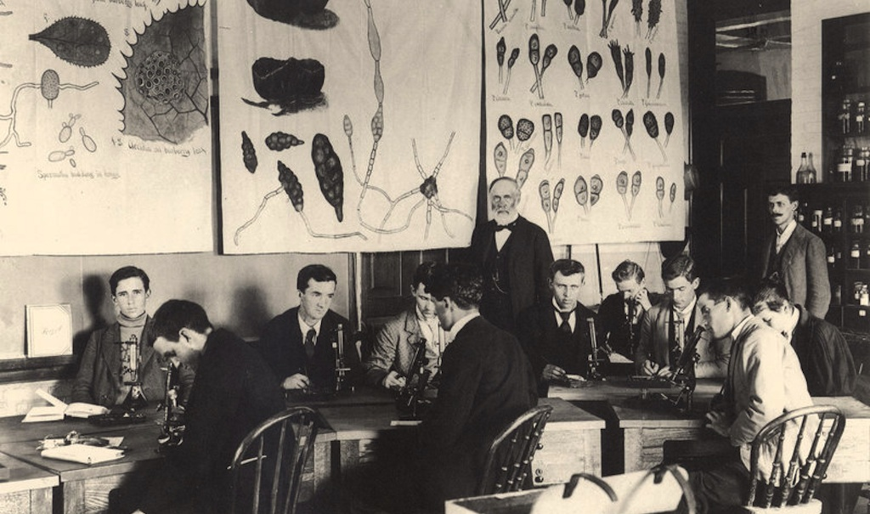
Methods: OEGREs
msu.edu
Notes:
Map of eastern US to global map with points all over the world

Slide 27
Methods

Slide 28
Project Status

Slide 29
Seasonal Priority Effects

Slide 30
Seasonal Priority Effects

